Slide 1

Rapid Development with CakePHP
View PHP & MySQL with MVC Frameworks course details at www.edureka.co/php-mysql
For Queries:
Post on Twitter @edurekaIN: #askEdureka
Post on Facebook /edurekaIN
For more details please contact us:
US : 1800 275 9730 (toll free)
INDIA : +91 88808 62004
Email us : sales@edureka.co

Slide 2
Objectives
At the end of this module, you will be able to understand:
MVC Architecture
CakePHP Introduction
Why to Use CakePHP
How to Configure CakePHP
Creating a Simple Web Application Using CakePHP
Notes:
PRD layout, Understanding it's basic features, designing basic report containing graphical chart, Conditional Formatting, studying the PRPT file format, building a basic report in PDF report

Slide 3
Drawbacks of Designing an Application Without Using a Framework
Coding in straight PHP can lead to spaghetti code. Long lines of code that have multiple interactions and typically have HTML code in it
Leads to disorganization
Difficult to re-use code
Change one thing, break another
Everything must be tested, which is difficult
Hard code everything from scratch
Teamwork challenges - parallel programming cannot be done efficiently
Design Patterns is a way to organize a program in a proper manner
One such design pattern is MVC

Slide 4
MVC Introduction
Introduction – What is MVC
MVC is acronym for Model-View-Controller
MVC is software design pattern for developing web and desktop applications
It separates the application logic in easily manageable containers viz Model, View and Controller

Slide 5
MVC Introduction - Model
Model
The Model container manages the data and business logic of the application
Model receives requests for data access from View
It also receives requests from Controller to update the data
Model encapsulates the database and file access from rest of the application logic

Slide 6
MVC Introduction - View
View
The View container manages the presentation of data in specific format
Each model can have multiple views associated with it
View handles all the user interface elements e.g. forms, tables, formatted data
View also implements templates to unify the overall look and feel of the website

Slide 7
MVC Introduction - Controller
Controller
The Controller container manages all the communication between Model and view
Controller is the entry point of all the requests made in the web application
Controller responds to the events, communicate with model and sets data for view
Controller can be considered as brain of the application

Slide 8

MVC Introduction - Illustration
Data object Request
HTTP Request
CONTROLLER
Web Browser/Client
MODEL
Data Objects Response
HTTP Response
Handled by Framework (Hidden from user)
Raw Data Response
Database Request
Events (GET/POST)
Render data
Database
http://www.mywebsite.com
VIEW
Website User
MVC Container

Slide 9
CakePHP - Introduction
What is CakePHP?
It is free, open source, rapid development framework for PHP
Follows and implements MVC architecture
Provides a basic structure for organizing files and database table names - keeping everything consistent and logical.
Other available frameworks are Zend framework, CodeIgniter, Laravel etc.

Slide 10
CakePHP - Introduction
Why CakePHP?
Open source with flexible licensing
Supports MVC architecture
Easy to install with minimal configuration, faster to learn
Powerful in-build form validation using models
CakeBake to generate ready to use code
Integrated CRUD for database interaction
View helpers for AJAX, JavaScript, HTML forms and more
Email, cookie, security, session, and request handling Components

Slide 11

Cake PHP Features
Code generation and scaffolding
Scaffolding is a programming technique popularized by Ruby on Rails where code is generated for basic DB operations
Out-of-the-box functionality
DB Support, Form creation , validation Users, authentication
Easy configuration
Two changes to a file, generate database config
Community
Strong, Active
Maintained Plugins
Clean MVC Implementation
Industry standard design pattern
Structured application
Easy for developers to read
Cake PHP for a long time from 2005
Broad user base
Available documentation

Slide 12
CakePHP - Prerequisite
Prerequisite for CakePHP 2.5.6
Apache httpd server 2.4
PHP 5.2.8 or higher
MySQL 4 or higher
We are assuming that we already have PHP and MySQL setup running on the machine

Slide 13
Configuring CakePHP (Contd…)
Download the CakePHP version 2.5.6 zip file from https://github.com/cakephp/cakephp/archive/2.5.6.zip
Extract the zip file to the apache webserver document root directory
To get the document root directory location –
Browse to Apache 2.4 directory
Click on conf folder and edit the httpd.conf file
Find the word “DocumentRoot”. It will have the document root directory path.

Slide 14
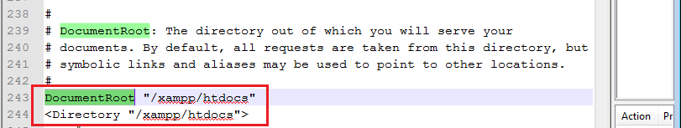
Configuring CakePHP (Contd…)
Document root

Slide 15
Configuring CakePHP (Contd…)
Now Start the apache and MySQL server if it is not already running.
Open web browser and enter http://localhost/cakephp-2.5.6/
Browser will show the CakePHP index page. This means your CakePHP has been setup correctly.
There are some warnings displayed in the index page. We will resolve them in post installation steps next.

Slide 16
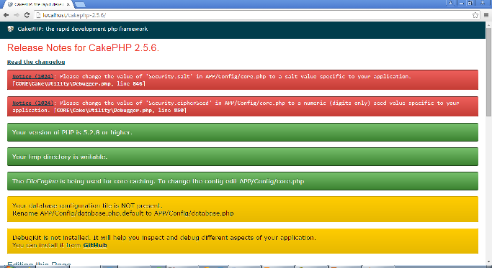
Configuring CakePHP (Contd…)
Check the installation - Output

Slide 17
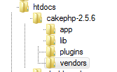
CakePHP folder structure
CakePHP core directories
There are 4 core directories under CakePHP
app, lib, plugins and vendors

Slide 18
CakePHP folder structure
CakePHP core directories
app
Main working directory for CakePHP development
Contains all custom application code including model, view and controller.
Also contains public webroot directory (document root)
lib
Contains all the core CakePHP libraries
DO NOT modify any files in this directory as it will affect the core CakePHP functionality
plugins
Empty by default
Can contain custom plugins made available to enhance CakePHP functionality
vendors
Empty by default
Can contains third party libraries

Slide 19
Creating a Simple Web Application Using CakePHP
User Management System
A Web application to display all the user details with an option to add a new user, edit an existing user and to delete a user using CakePHP
Application to perform simple CRUD (Create, Read, Update and Delete) operations
Create a Database with name 'Edureka' mysql> create database Edureka
Create a Database Table with name "users" in "Edureka" Database with the following fields ID FIRST_NAME LAST_NAME EMAIL MOBILE

